Slide 1
Why Value-Added?
Luncheon Keynote
May 17, 2013

Slide 2
Lunchtime Keynote: Learning Outcomes
Not just an excuse to pay for lunch.
Entertain you a bit.
Stimulate your thinking.
Leave you with a little learning.
Make you feel like this is worth it.

Slide 3
Why did you get into education?
I teach to…
Help kids pass tests.
Help kids LEARN!

Slide 4
Measuring Educator Effectiveness
A strategic measure is one that:
  guides you from where you are to where you want to be
  separates what you think is happening from what is actually happening

Slide 5

What are we measuring?

Slide 6

If it were only this simple…
We teach. They learn.

Slide 7
Measures of Effective Teaching
The Bill & Melinda Gates Foundation
Two years (2009–2010, 2010–2011)
3,000 teachers from seven districts:
  Charlotte-Mecklenburg, New York City, Hillsborough County, Denver, Memphis, Dallas, Pittsburgh
Five types of data
  Improvement in student achievement
  Classroom observations and teacher reflections
  Pedagogical content knowledge
  Student perceptions of classroom environment
  Teacher perceptions of working conditions and support

Slide 8
Multiple Measures
“Not just multiple measures, but the RIGHT measures…”
Measures to complete the picture of success.

Slide 9
Beyond Accountability
Accountability measures results.
We need to evolve to manage behavior and results.

Slide 10
The Four P’s
Professionalism
Practice
Perception
Performance
Observe
Survey
Assess &
Analyze

Slide 11
Four P’s of Measures
Professionalism Measures
Definition: Professionalism is how you, as a teacher, act and interact with other professionals, peers, parents, and stakeholders to engage in a teaching and learning environment conducive to success. You seek to learn, to get help, to provide help, support others, engage others and care as an education professional supporting the interest of all students.

Slide 12
Professionalism: Gallup Q12
  Q00. How satisfied are you with (your school) as a place to work?
  Q01. I know what is expected of me at work.
  Q02. I have the materials and equipment I need to do my work right.
  Q04. In the last seven days, I have received recognition or praise for doing good work.
  Q05. My principal, or someone at work, seems to care about me as a person.
  Q06. There is someone at work who encourages my development.
  Q07. At work, my opinions seem to count.
  Q08. The mission or purpose of my company (school) makes me feel my job is important.
  Q09. My associates or fellow employees are committed to doing quality work.
  Q10. I have a best friend at work.
  Q11. In the last six months, someone at work has talked to me about my progress.
  Q12. This last year, I have had opportunities at work to learn and grow.

Slide 13
Four P’s of measures
Practice Measures
Definition: Measures that assess activities, processes, and interventions used to affect performance measures and educational outcomes.
  Examples:
    Observation frameworks: Danielson, Marzano
    Teaching artifacts
    Advanced degree/certification completion
    Participation in professional learning or PLC

Slide 14
Four P’s of Measures
Perception Measures – Feedback for Improvement
Definition: Measures the views or beliefs of stakeholders about the environment, processes and outcomes.
  Examples:
    The Student Experience: BFK and Gallup
    Tripod Teacher, Student, and Parent Surveys
    Education for the Future Questionnaires
    Profiles of Student Life: Attitudes & BehaviorsTM

Slide 15

The Student ExperienceTM Survey
Hope
Engagement
Belonging
Classroom Management
www.thestudentexperience.org

Slide 16
Hopeful Students…
Believe their future will be better than their present.
Understand there are multiple pathways to success.
Understand that there will be obstacles…and they plan for them.
Gallup’s longitudinal GSP research indicates that Hope is a more robust predictor of college success than ACT, SAT, and GPA.

Slide 17
Hope Items
Adapted from Gallup Student Poll
This teacher cares about my future.
I know I will get a good grade in this class.
I can think of many ways to get good grades in this class.
I am excited about reaching my goals in this class.
I can find lots of ways around any problem in this class.
This teacher makes me excited about my future.

Slide 18
Four P’s of Measures
Performance Measures
Definition: Measures that assess educational outcomes resulting from activities, processes, and practices.
  Examples:
    Achievement scores
    Growth or value-added
    Student Learning Outcomes (SLO)
    Graduation rates
    College placement exams (e.g., ACT/SAT)

Slide 19
Leading vs. Misleading
Why not achievement alone?
Who needs value-added measures?

Slide 20
Exploring Achievement by Grade
Notes:
What do you think of your school’s performance in grade 2? Grade 3? Grade 4?

Slide 21
Statewide Mean Scale Score
Notes:
When examining the State of California’s ELA scores, does the overall pattern of performance statewide in California show a different strength or challenge grade than our school?

Slide 22
My School Compared to State
Notes:
In looking at my school compared to the state, does this graph change your thinking about your school’s performance in grade 3 and grade 4?
Pause for reflective answers.

Slide 23
Value-Added
Value-added models measure the influence of schools or teachers on the academic growth rates of students.
Value-added compares the change in achievement of a group of students from one year to the next to an expected (mathematically predicted) performance level based on prior their achievement history and other potential influences.

Slide 24
The Power of Two
In which quadrant would you want your school to be?
If you couldn’t choose the upper right, in which quadrant would you want your school to be?
In which quadrant would you not want your school?
Low Growth
High Achievement
High Growth
High Achievement
School A
School J
School H
Achievement
School C
School K
School G
School F
School B
School D
Low Growth
Low Achievement
High Growth
Low Achievement
Value-Added Growth
Notes:
Follow screen prompts and facilitate discussion questions. Probe for reasons why.
Discussion (when top-right quadrant removed): When asked, which quadrant do most teachers choose? Principals? Central office administrators?
Typically, teachers choose the lower-right corner. Principal results here are mixed with elementary leaning lower-right while secondary leaning upper left. Central office administrators almost all upper-left.

Slide 25
Example Process Model:
Putting It All Together
Trust
Collaboration
Leadership
Support
Professional Learning
Relationships
Performance Band
Growth
Intervention
Remediation
Teacher
Content Knowledge
Standards
Curriculum
Pedagogy
Classroom Management
Student Engagement
Planning & Preparation
Student
Assessment FOR Learning
Critical Thinking
Ownership
Inquiry
Classroom Environment
Professionalism
Practice
Perception
Performance

Slide 26
Is it important? What’s the impact?
Trust
Collaboration
Leadership
Support
Professional Learning
Relationships
Performance Band
Growth
Intervention
Remediation
Teacher
Content Knowledge
Standards
Curriculum
Pedagogy
Classroom Management
Student Engagement
Planning & Preparation
Student
Assessment FOR Learning
Critical Thinking
Ownership
Inquiry
Classroom Environment
Professionalism
Practice
Perception
Performance

Slide 27

Explaining Value-Added
Hocus focus voo-doo magic by doctors who don’t see patients.
Predictions are more like magic than science.

Slide 28
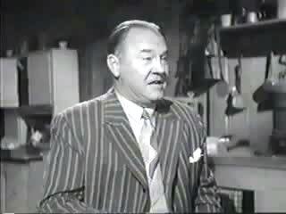
Ma’s Mysterious Math

Slide 29
Harnessing the Power of Data
Explain Value-Added method and processes?
Understand how to respond to the data.
  Interpret signals
  Root causes
  Planned response

Slide 30

Interpreting Signals

Slide 31
How do you respond to the data?
Researchers and data analysts like data.
People respond to information.
  The power of visual display of data – signals.
  For Gear Up, we tried to create reports that had a visual representation of value-added results.
Analysis: Strength-leveraging and problem-solving

Slide 32
Root Cause Analysis
Uncovering Factors that contribute to particular outcomes
  Curriculum
  Quality of Instruction
  Leadership
  Structure

Slide 33
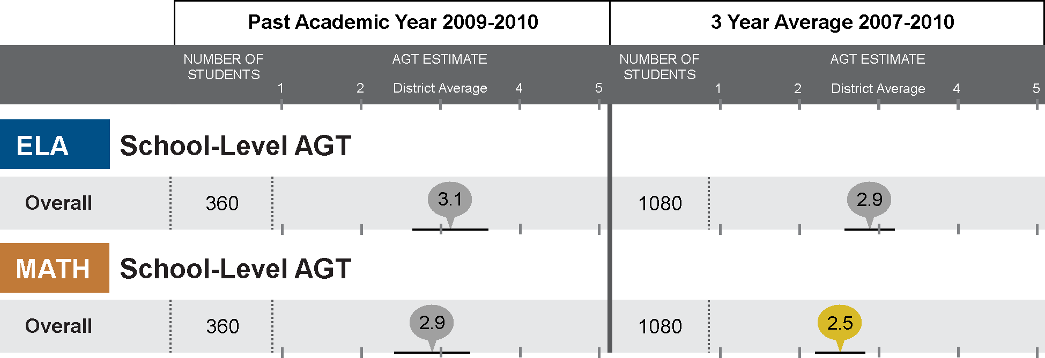
Value-Added Reporting
READING

Slide 34
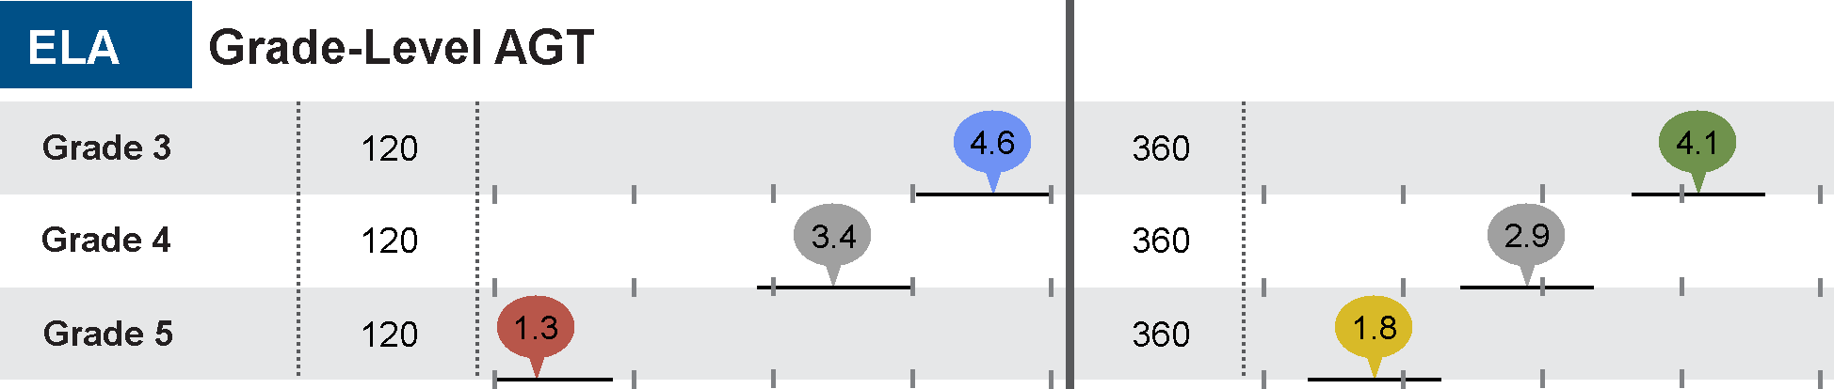
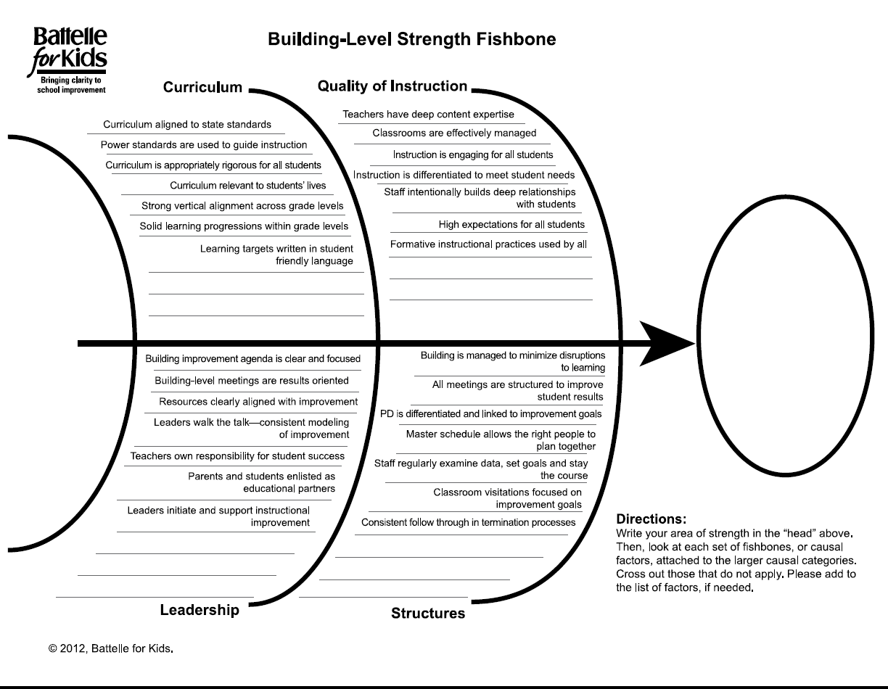
Grade-Level Results
READING
Grade 6
Grade 7
Grade 8
What could be contributing to our strengths? Our problems? Develop a hypothesis related to:
  Curriculum
  Quality of Instruction
  Leadership – Shared Vision
  Structure

Slide 35
Benefits of Value-Added
Opportunities due to insights from data
Notes:
These data provide a key piece of information about the effectiveness of teachers and schools in creating student growth. Districts and states around the country are using these data for a variety of purposes but, above all, these data have the power to help us increase student learning. This is not just an issue that we focus on at the secondary level, but across all grade levels.

Slide 36
Opportunity
  To provide a clearer understanding of where your strengths and challenges are allowing you to create more focused improvement efforts
  Your district 6th grade math performance are low but your schools that are configured (K-6 or K-8) are show positive value added results
  Your previously high achieving 7th grade reading students in your building are not meeting growth predictions?

Slide 37
Opportunity
  to evaluate where your curriculum or programs are being more or less effective
  Your math value-added results across an entire grade level in your district demonstrated low value-added.
  Students in your gifted magnet school demonstrated less academic growth than similar students in traditional schools?

Slide 38
Opportunity
  to improve your placement of teachers and students
  Your value-added results indicate that 4 of your most ineffective math teachers are in the same middle school.
A 4th grade teacher in your building has very high value-added effects in math but very poor value-added effects in reading.

Slide 39
An opportunity
  to maximize the impact of your best teachers and principals
  You identify really highly effective teachers and share what makes them successful with others.
You identify new ways use highly effective teachers to reach more students, high needs students, or lead the development of other teachers.

Slide 40
An opportunity
  to target professional development at needs of the teacher or group of teachers
  Examples:
  Develop protocols that lead teachers through a data inquiry, root cause analysis, and goal setting process.
Align professional development to your instructional framework and promote collaboration across the organization.

Slide 41
www.BattelleforKids.org http://twitter.com/BattelleforKids

